Slide 1

Nordic Retail Group
Financial Report

Slide 2
Background & Objective
Background
Fragmented and manual financial reporting limits visibility.
NRG’s financial data is fragmented and manually reconciled, causing inconsistencies, errors, and reporting delays.
Limited cost visibility makes it difficult to monitor profitability, COGS, operational expenses, and budget performance.
The Objective
A structured financial dataset and centralized analytics dashboard.
Build a centralized financial dataset and automated reporting system for faster, more accurate decision-making.
Improve profitability and cost control through P&L, balance sheet, and Budget vs. Actual analysis.

Slide 3
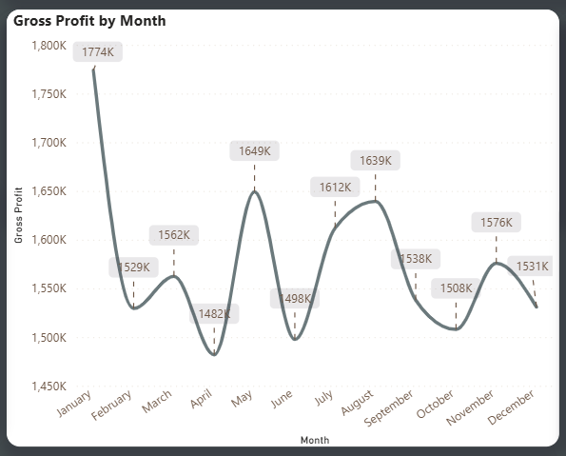
Profitability
a. Gross Profit
Peak & Lowest Points
Gross profit peaked in January at 1.774M and reached its lowest level in April at 1.482M, a decline of 16.5%.
Strongest Recovery
Occurred from April to May, increasing by 167K (11.3%), followed by strong performance in July–August.
Year-End Performance
Recovered to 1.576M in November but declined to 1.531M in December, closing 13.7% below January.

Slide 4
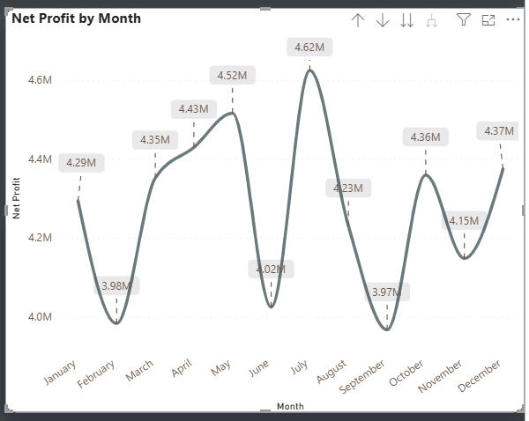
b. Net Profit
Peak & Lowest Points
Net profit peaked in July at 4.62M and reached its lowest level in September at 3.97M, showing significant monthly volatility.
Strongest Recovery
Occurred from June to July, increasing by 0.60M (14.9%), followed by a decline of 14.1% from July to September.
Year-End Performance
Net profit closed at 4.37M in December, which is approximately 1.9% higher than January’s 4.29M.

Slide 5
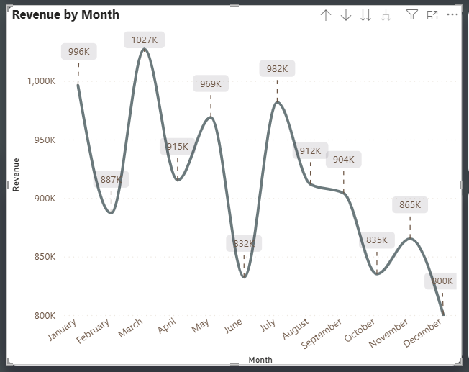
Profitability
c. Revenue
Peak & Lowest Points
Revenue peaked in March at 1.027M and reached its lowest level in December at 800K.
Strongest Recovery
Occurred from June to July, increasing by 150K (18.0%) after falling to 832K in June.
Year-End Performance
Revenue declined from 996K in January to 800K in December, representing an overall decrease of 19.7%.

Slide 6
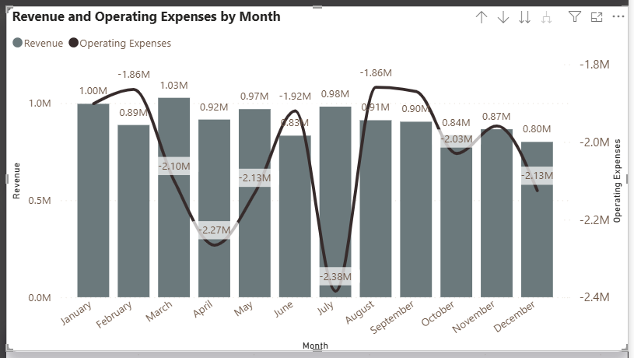
Operation
Revenue Trends
Revenue peaked in March at 1.03M and fell to its lowest level of 0.80M in December, a decline of approximately 22.3%.
Operating Expenses Peak
Operating expenses reached their highest magnitude in July at 2.38M, despite revenue remaining relatively strong at 0.98M.
Cost Pressure & Deficit
Operating expenses exceeded revenue in every month; December recorded the largest cost pressure, with expenses approximately 2.66 times revenue.

Slide 7
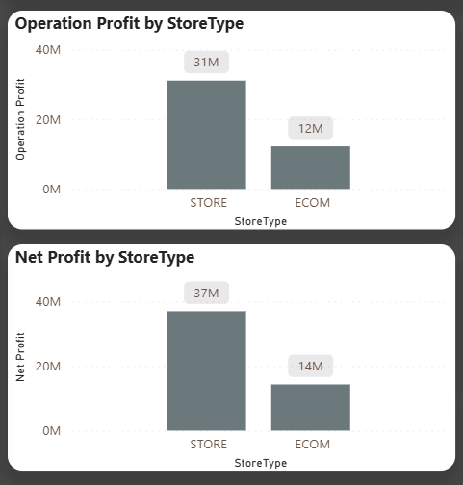
Operation
Operating Profit
Physical stores generated 31M in operating profit, approximately 2.6 times E-commerce’s 12M, contributing 72% of total.
Net Profit
Store net profit reached 37M, compared with 14M from E-commerce, representing approximately 73% of total net profit.
Strategic Outlook
Both channels are profitable, but E-commerce requires revenue growth and cost-efficiency improvements to narrow the gap.

Slide 8
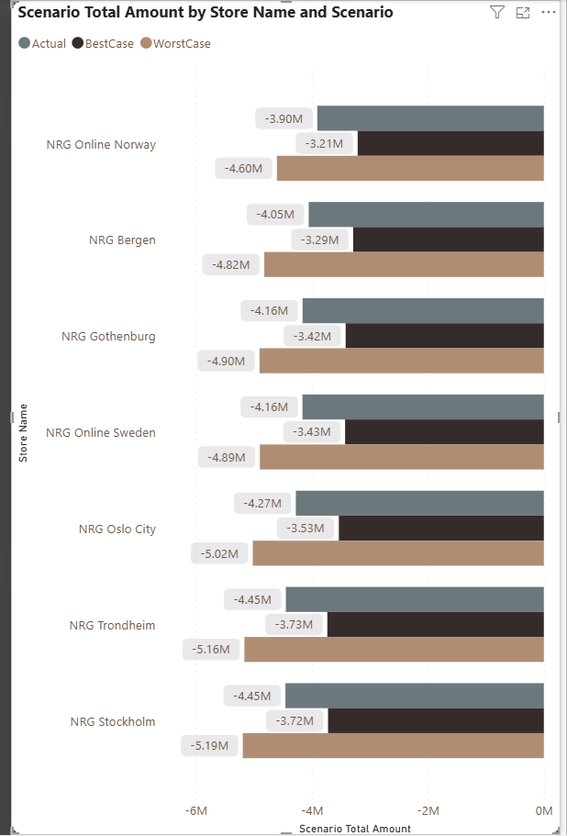
Scenario Analytics
Favorable Results
NRG Online Norway recorded the most favorable actual result at −3.90M, followed by NRG Bergen at −4.05M.
Weakest Performance
NRG Trondheim and NRG Stockholm recorded the weakest actual results at −4.45M, while Stockholm had the greatest downside risk at −5.19M.
Cost-Control Priority
Cost-control initiatives should prioritize Stockholm, Trondheim, and Oslo City, as these stores recorded the highest negative actual amounts.

Slide 9
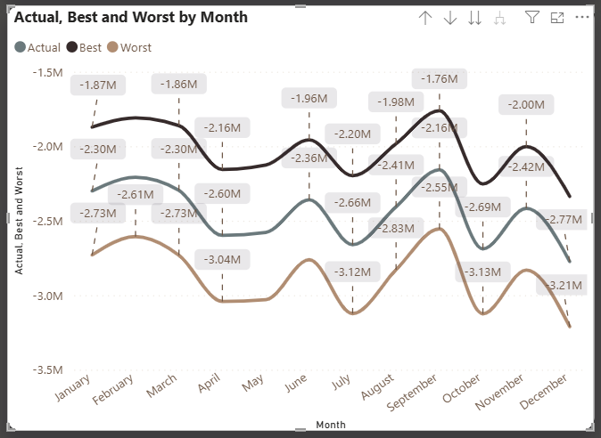
Scenario Analytics
Scenario Range
Actual performance remained between the best- and worst-case scenarios throughout 2025, with no scenario-range breaches.
September Peak
September recorded the most favorable actual result at −2.16M, compared with a best case of −1.76M and a worst case of −2.55M.
December Decline
December recorded the weakest actual result at −2.77M, deteriorating by 0.61M (28.2%) from September and approaching the worst-case value of −3.21M.

Slide 10
Conclusions
2025 Performance
NRG remained profitable in 2025, but performance was volatile and revenue declined by 19.7% from January to December [cite: 10].
Channel & Locations
Physical stores contributed approximately 73% of total profit, while E-commerce and locations like Stockholm, Trondheim, and Oslo City show opportunities for improvement [cite: 10].
Strategic Imperatives
Stronger cost control, revenue recovery, reporting automation, and validation of financial KPI calculations are essential for faster decision-making [cite: 10].

Slide 11
Recommendations & Actions
Recommendations
Validate financial metrics to ensure consistent and accurate reporting.
Recover revenue growth by replicating strategies from high-performing months.
Control operating expenses, particularly logistics and marketing costs.
Improve E-commerce and underperforming store profitability.
Automate financial reporting for faster, data-driven decisions.
Actions
Standardize KPI definitions and validate financial calculations.
Analyze revenue performance by department, store, and product.
Monitor Budget vs. Actual variance monthly.
Review E-commerce and underperforming store costs.
Automate P&L and performance dashboards.

